Slide 1

The Fed Model: Putting it All Together
Copyright © 2023 by Macmillan Learning. All rights reserved
PRINCIPLES OF ECONOMICS
Betsey Stevenson – Justin Wolfers | Second Edition

Slide 2
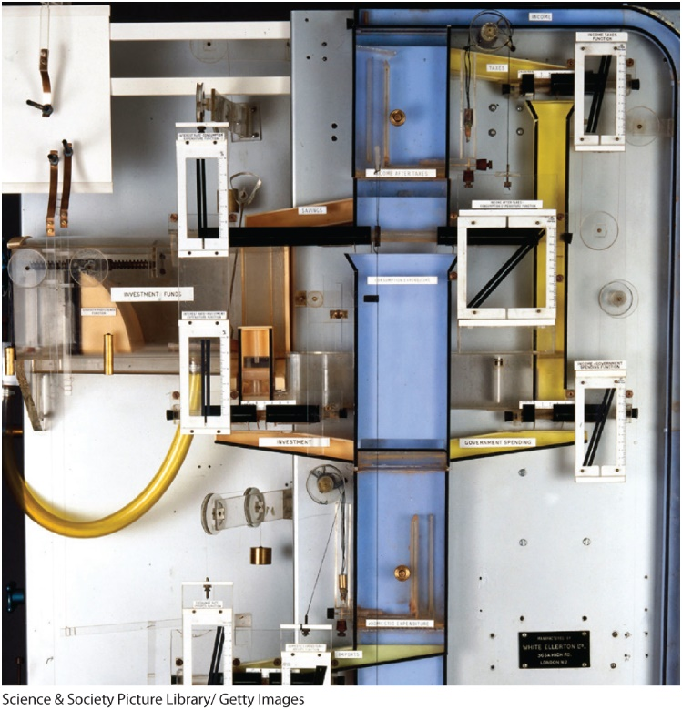
Objective
Put the pieces together into a complete model of the business cycle.
Notes:
Lecture tips:
Discuss with students the big picture of this chapter, including how interest rates, output, and inflation are related.

Slide 3
Roadmap (1 of 3)
The Fed Model
Analyze the Fed model, which puts together the IS curve, the MP curve, and the Phillips curve.
Analyzing Macroeconomic Shocks
Use the Fed model to analyze the consequences of financial shocks, spending shocks, and supply shocks.
Diagnosing the Causes of Macroeconomic Changes
Use the Fed model to diagnose the causes of economic fluctuations.

Slide 4
The Fed Model
The Fed model is a framework that uses the IS curve, the MP curve, and the Phillips curve to link interest rates, the output gap, and inflation.
Policy makers and professional economists use the model to analyze, forecast, and tweak the economy.
Notes:
Lecture tips:
Note to students that this chapter and its discussion of the Fed model bring together the previous chapters regarding the business cycle.

Slide 5
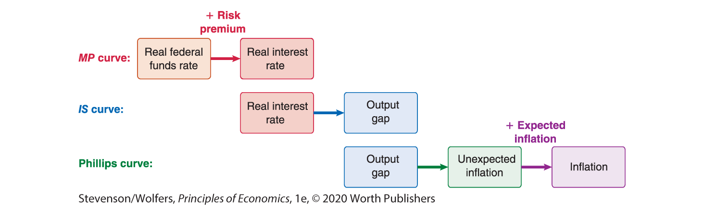
What We Have Learned So Far
Notes:
Lecture tips:
Briefly review the relationships being illustrated in each curve.

Slide 6
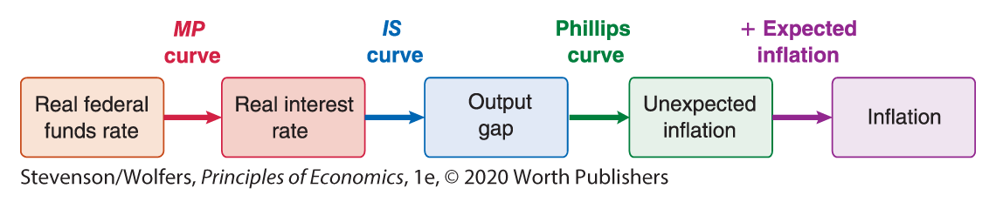
Combining What We Know to Create the Fed Model
Notes:
Lecture tips:
Putting the pieces together allows you to forecast interest rates, the output gap, and inflation.

Slide 7
Forecasting Economic Outcomes
Second, use the IS-MP framework to determine the output gap.
Next, use the Philips curve to assess inflation.
Notes:
Lecture tips:
You might want to review what each axis represents on the IS-MP framework and Philips curve.

Slide 8
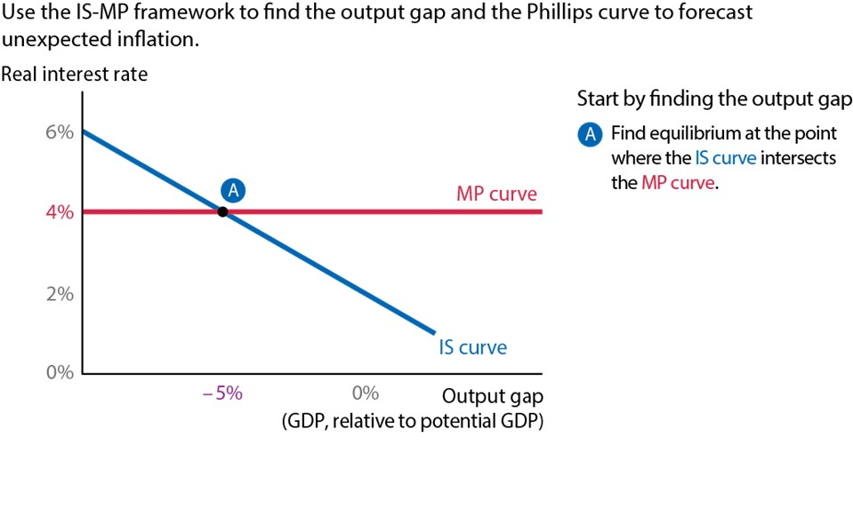
The Fed Model - Step 1
Notes:
The Fed Model - Step 1
The Fed model uses both the IS-MP framework and the Phillips curve. The Second step is to identify equilibrium, which occurs where the IS and MP curves intersect.

Slide 9
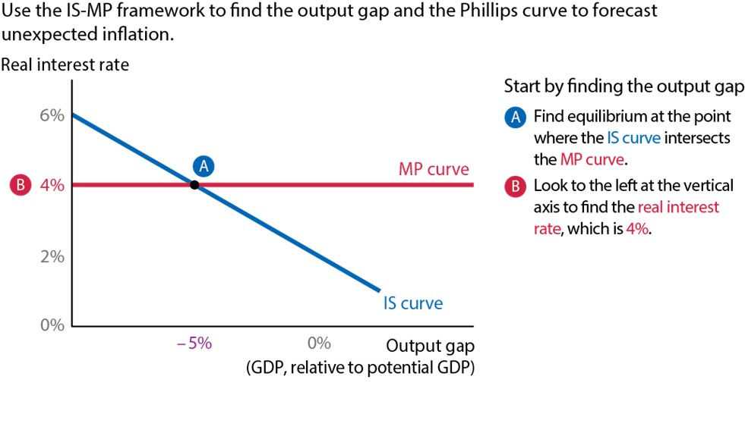
The Fed Model - Step 2
Notes:
The Fed Model - Step 2
Looking to the left of the equilibrium, the real interest rate is 4%.

Slide 10
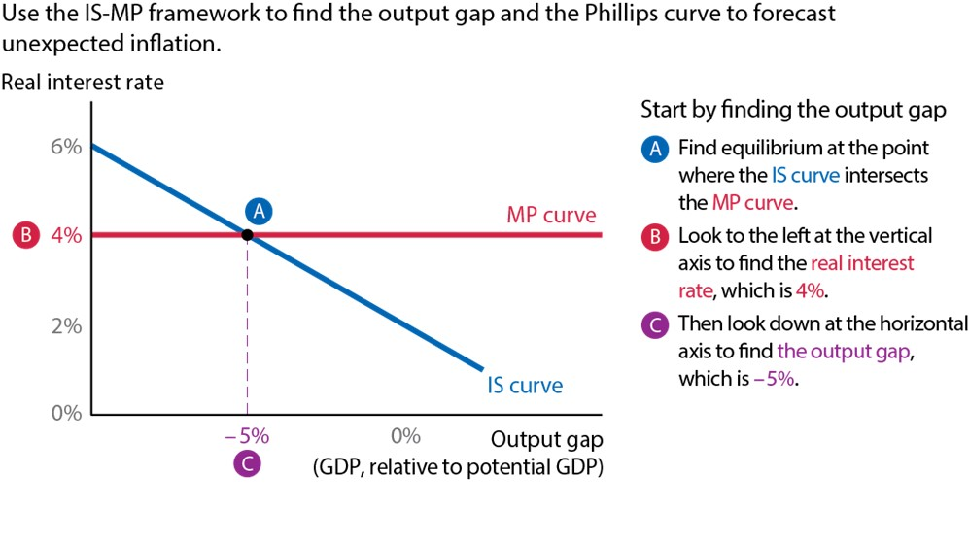
The Fed Model - Step 3
Notes:
The Fed Model - Step 3
Looking down from equilibrium, the output gap is -5%.

Slide 11
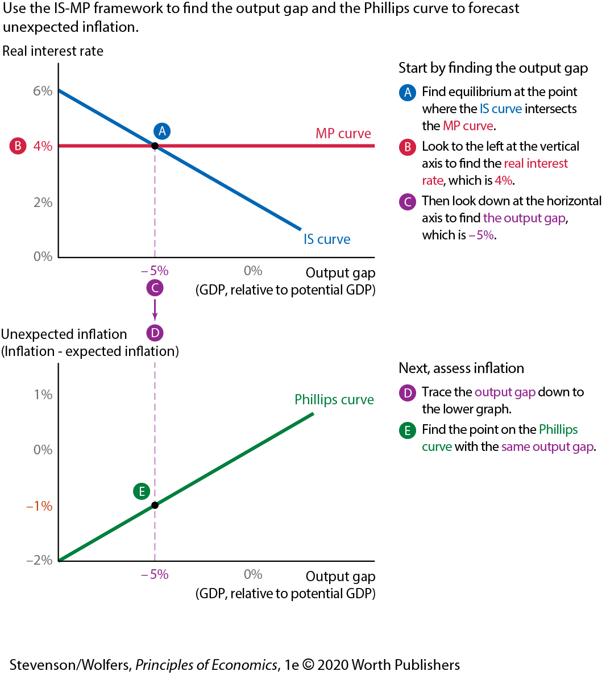
The Fed Model - Step 4
Notes:
The Fed Model - Step 4
Looking at the Phillips curve, the next step is to identify the point that corresponds to the same output gap.

Slide 12
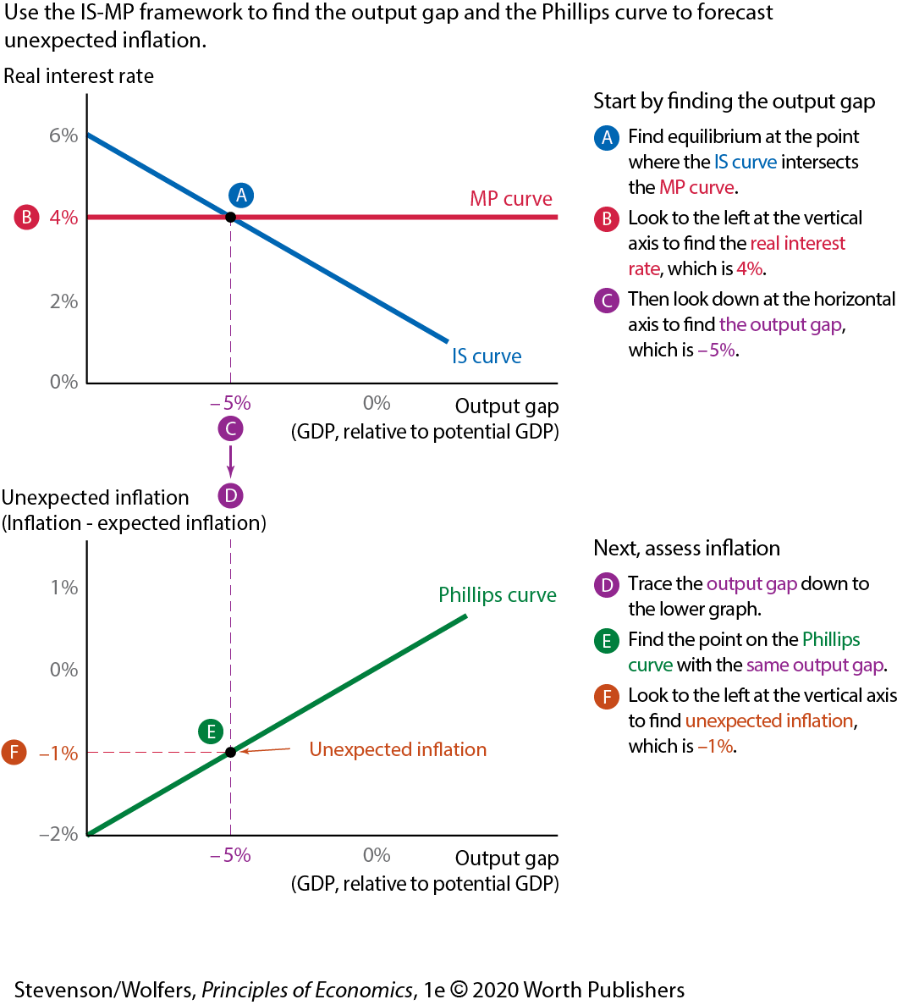
The Fed Model - Step 5
Notes:
The Fed Model - Step 5
Looking to the left of this point, the unexpected inflation is -1%.

Slide 13
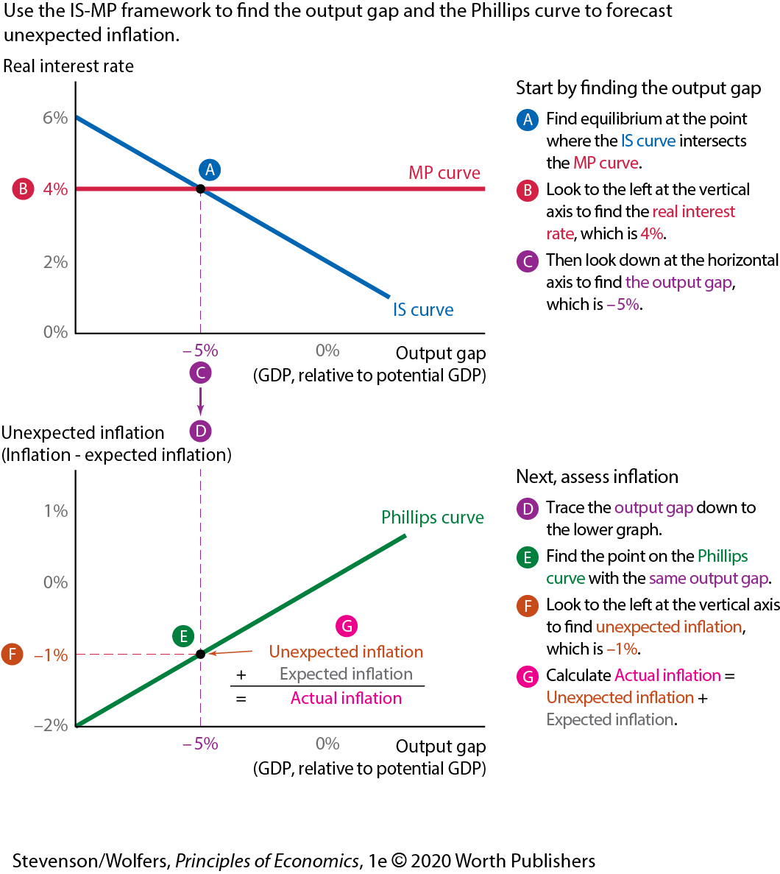
The Fed Model - Step 6
Notes:
The Fed Model - Step 6
Actual inflation can be calculated as the sum of unexpected inflation and expected inflation.

Slide 14
Three Types of Macroeconomic Shocks
Financial shocks
Spending shocks
Supply shocks
The Fed model brings together three curves, which are shifted by these three kinds of shocks.

Slide 15
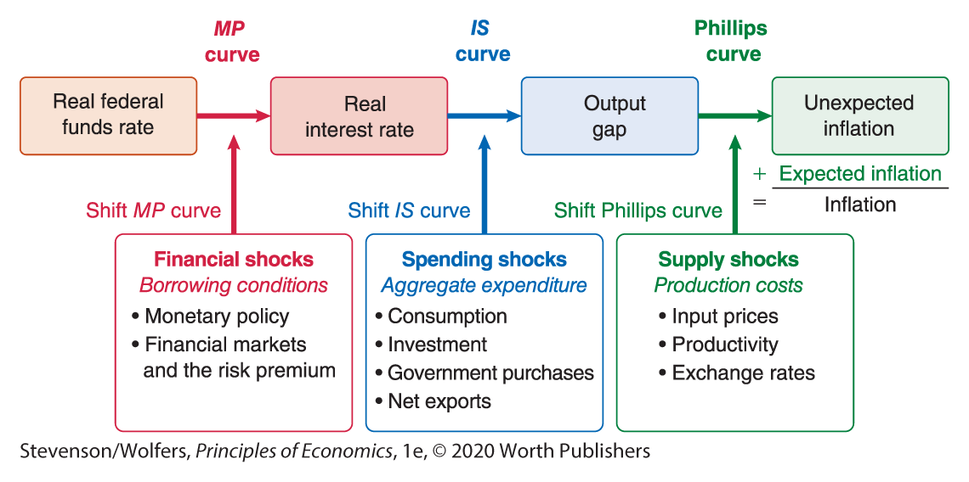
The Complete Fed Model Framework
Notes:
Lecture tips:
Second, assess the change in economic conditions, and determine which type of shock has occurred.
Next, explore how that type of shock will affect the economy.

Slide 16
Macroeconomic Shock 1: Financial Shocks
A financial shock is any change in borrowing conditions that alters the real interest rate at which people can borrow.
Financial shocks shift the MP curve.
Notes:
Lecture tips:
This occurs when the Fed changes the federal funds rate or when there is a change in the risk premium.

Slide 17
Macroeconomic Shock 2: Spending Shocks
A spending shock is any change in aggregate expenditures at a given real interest rate and level of income.
Spending shocks shift the IS curve.
Notes:
Lecture tips:
Spending shocks may be due to consumption, planned investment, government expenditure, or net exports.

Slide 18
Macroeconomic Shock 3: Supply Shocks
A supply shock is any change in production costs that leads suppliers to change the prices they charge at any given level of output.
Supply shocks shift the Phillips curve.
Notes:
Lecture tips:
This could be caused by changes in input prices, productivity, or the exchange rate.

Slide 19

Clicker question (1 of 5)
The Chinese government eliminates the tariffs it charges on goods exported from the United States. This is illustrated in the Fed model by shifting the
IS curve upward.
IS curve downward.
Phillips curve upward.
Phillips curve downward.
- Correct Answer
Notes:
Answer: A
This is a spending shock. Eliminating tariffs reduces the prices of goods exported from the United States, increasing aggregate expenditures, which shifts the IS curve upwards.

Slide 20
Clicker question (2 of 5)
Improvements in manufacturing technology increase the productivity of many American firms. This is illustrated in the Fed model by shifting the
IS curve upward.
IS curve downward.
Phillips curve upward.
Phillips curve downward.
- Correct Answer
Notes:
Answer: D
Improved technology improves productivity and reduces production costs, which is a supply shock. It shifts the Phillips curve downward.

Slide 21
Review: The Fed Model
The Fed model is used to analyze, forecast, and tweak the economy.
The IS-MP framework determines the output gap, and the Philips curve determines inflation.
There are three types of macroeconomic shocks:
Financial shocks shift the MP curve.
Spending shocks shift the IS curve.
Supply shocks shift the Phillips curve.
Notes:
Lecture tips:
This slide is a brief review of the big takeaways from this section of the lecture, so it repeats some information from previous slides.

Slide 22
Roadmap (2 of 3)
The Fed Model
Analyze the Fed model, which puts together the IS curve, the MP curve, and the Phillips curve.
Analyzing Macroeconomic Shocks
Use the Fed model to analyze the consequences of financial shocks, spending shocks, and supply shocks.
Diagnosing the Causes of Macroeconomic Changes
Use the Fed model to diagnose the causes of economic fluctuations.

Slide 23
Recipe for Analyzing Macroeconomic Shocks
To analyze macroeconomic shocks, do the following:
Identify the shock, and shift the curve.
Find the output gap.
Assess inflation.
Notes:
Lecture tips:
The goal is to forecast how the economy will respond if a macroeconomic shock knocks it off its current path.

Slide 24
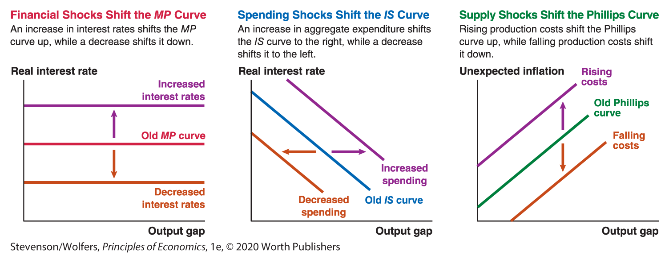
Types of Macroeconomic Shocks
Notes:
Lecture tips:
You may want to quiz students on various scenarios to see if they can determine which type of macroeconomic shock each represents.

Slide 25
Analyzing Financial Shocks
The MP curve shifts in response to monetary policy and financial market risk.
Higher interest rates lead to lower output and lower inflation.
Notes:
Lecture tips:
Discuss what will happen in the graphical depiction Second, and then go to the next slide to work through it with students.
You might ask students to attempt to draw the financial shock using the Fed model before going to the next slide.

Slide 26
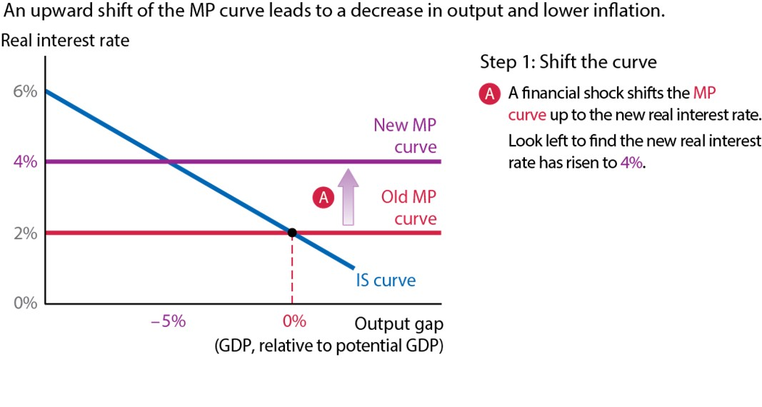
Financial Shocks Shift the MP Curve - Step 1
Notes:
Financial Shocks Shift the MP Curve - Step 1
Financial shocks shift the MP curve. In this case, a financial shock shifts the MP curve up. Looking to the left, the real interest rate rises from 2% to 4%.

Slide 27
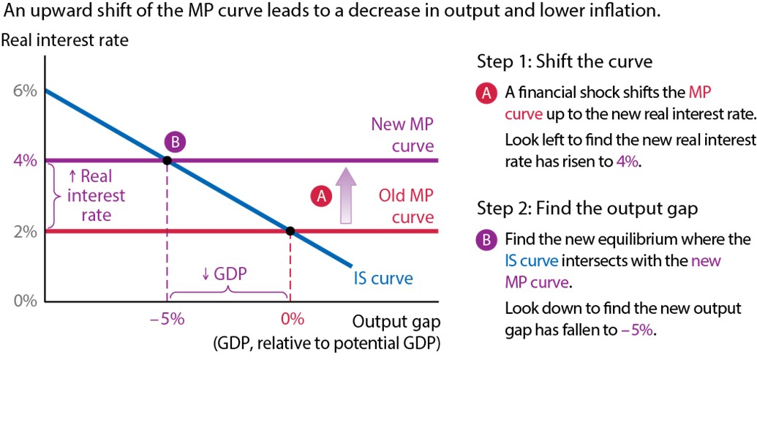
Financial Shocks Shift the MP Curve - Step 2
Notes:
Financial Shocks Shift the MP Curve - Step 2
The new equilibrium occurs where the new MP curve intersects the IS curve. Looking down from the equilibrium point, the output gap has fallen from 0% to -5%.

Slide 28
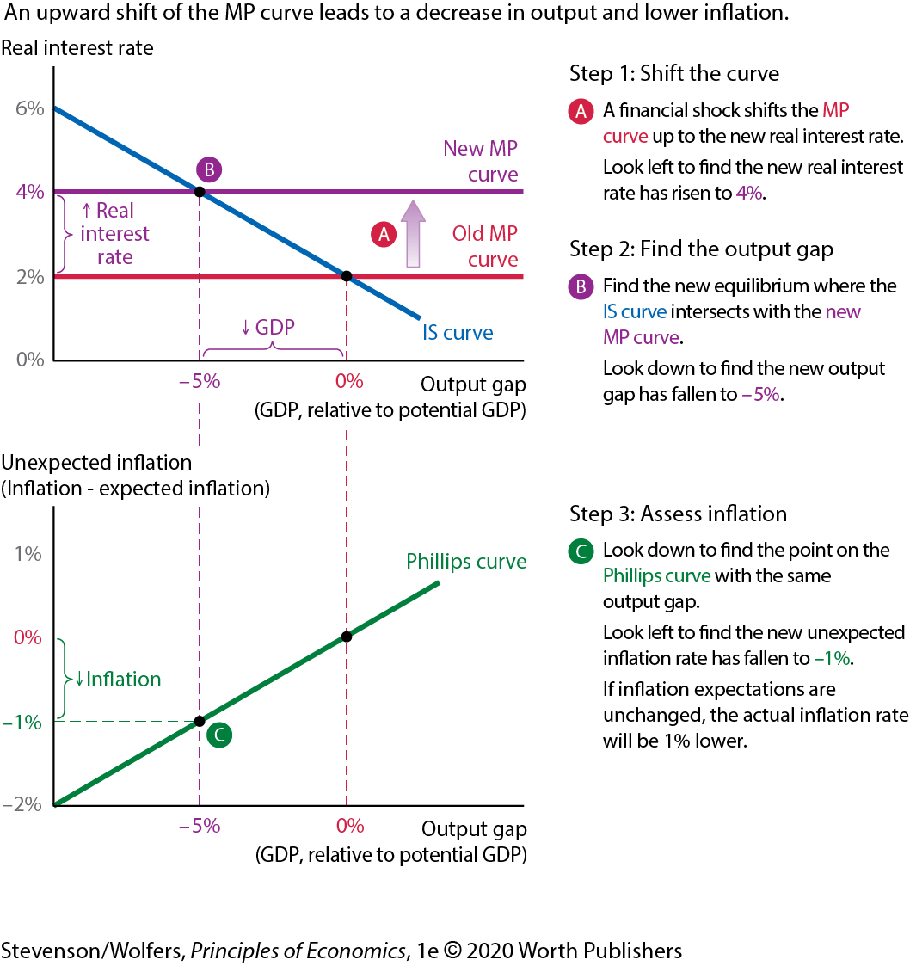
Financial Shocks Shift the MP Curve - Step 3
Notes:
Financial Shocks Shift the MP Curve - Step 3
Looking at the Phillips curve, the next step is to identify the point that corresponds to the same output gap. Looking left of that point, the unexpected inflation is -1%.

Slide 29
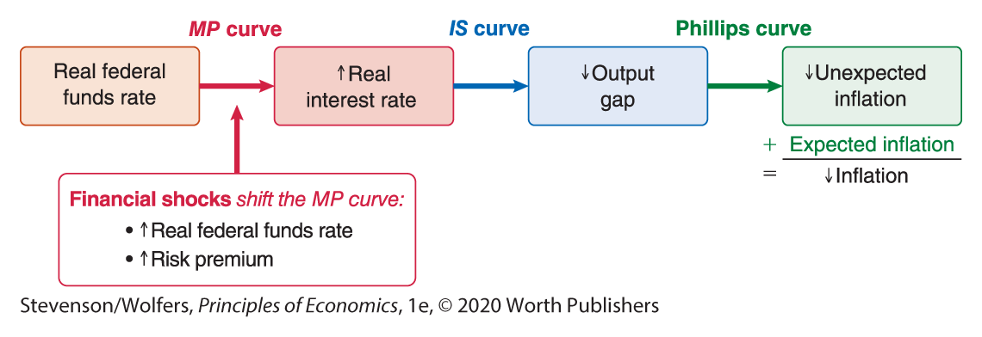
Track the Effects of a Financial Shock.
Notes:
Lecture tips:
A financial shock that shifts the MP curve up results in higher real interest rates, lower output, and lower inflation.

Slide 30
Analyzing Spending Shocks
The IS curve shifts in response to changes in aggregate expenditure.
The IS curve shifts by the change in spending times the multiplier.
Decreased aggregate expenditure leads to lower output and lower inflation.
Notes:
Lecture tips:
Ask students for examples of spending shocks. Remind them of each component of aggregate expenditure.

Slide 31
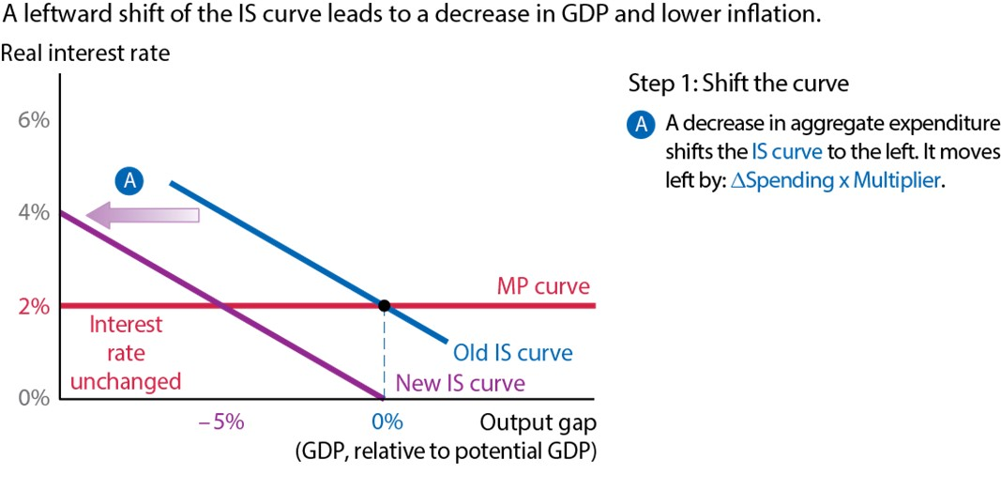
Spending Shocks Shift the IS Curve - Step 1
Notes:
Spending Shocks Shift the IS Curve - Step 1
Spending shocks shift the IS curve. In this case, a decrease in aggregate expenditure shifts the IS curve to the left by the change in spending times the multiplier. Looking to the left, the real interest rate remains unchanged.

Slide 32
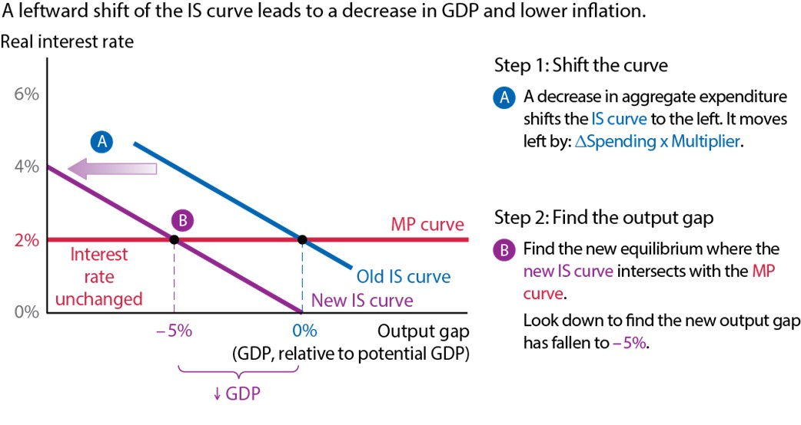
Spending Shocks Shift the IS Curve - Step 2
Notes:
Spending Shocks Shift the IS Curve - Step 2
The new equilibrium occurs where the new IS curve intersects the MP curve. Looking down from the equilibrium point, the output gap has fallen from 0% to -5%.

Slide 33
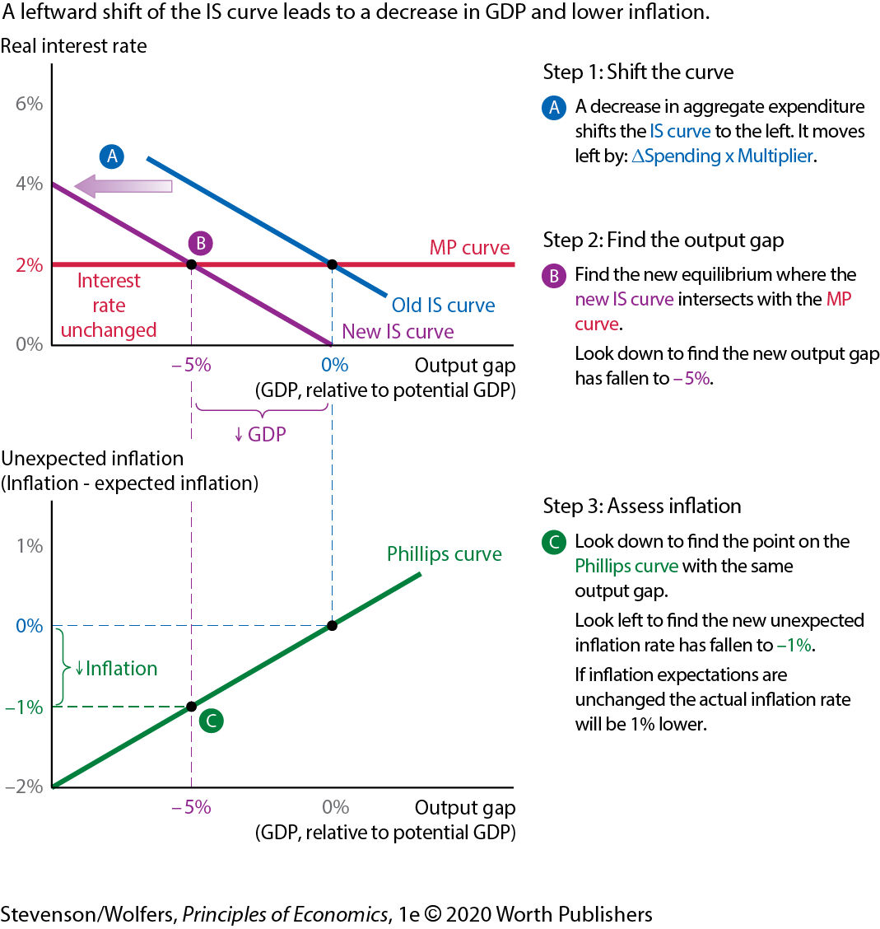
Spending Shocks Shift the IS Curve - Step 3
Notes:
Spending Shocks Shift the IS Curve - Step 3
Looking at the Phillips curve, the next step is to identify the point that corresponds to the same output gap. Looking left of that point, the unexpected inflation is -1%.

Slide 34
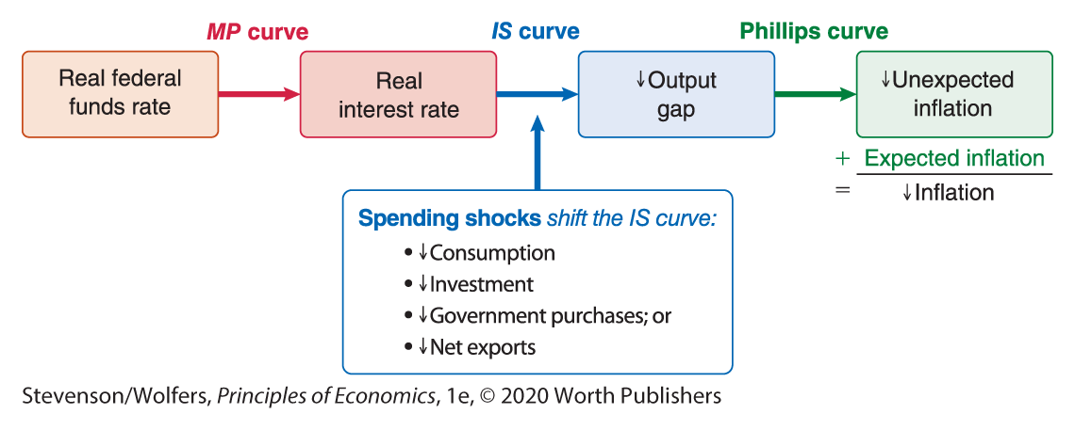
Track the Effects of a Spending Shock.
Notes:
Lecture tips:
A spending shock that shifts the IS curve left results in lower output, lower inflation, and no effect on the real interest rate.

Slide 35
Analyzing Supply Shocks
The Phillips curve shifts in response to changes in production costs.
Production costs shift in response to input prices, productivity, and exchange rates.
Increased production costs lead to higher inflation and no change in output.
Notes:
Lecture tips:
Ask students for examples of supply shocks.

Slide 36
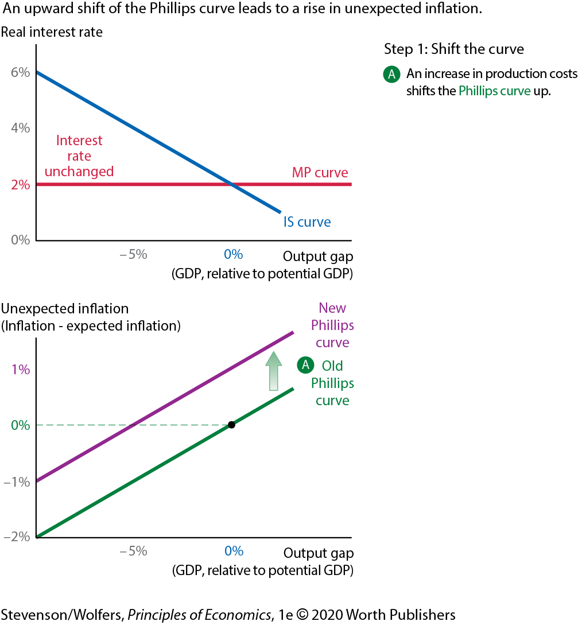
Supply Shocks Shift the Phillips Curve - Step 1
Notes:
Supply Shocks Shift the Phillips Curve - Step 1
Supply shocks shift the Phillips curve. In this case, an increase in production costs shifts the Phillips curve up.

Slide 37
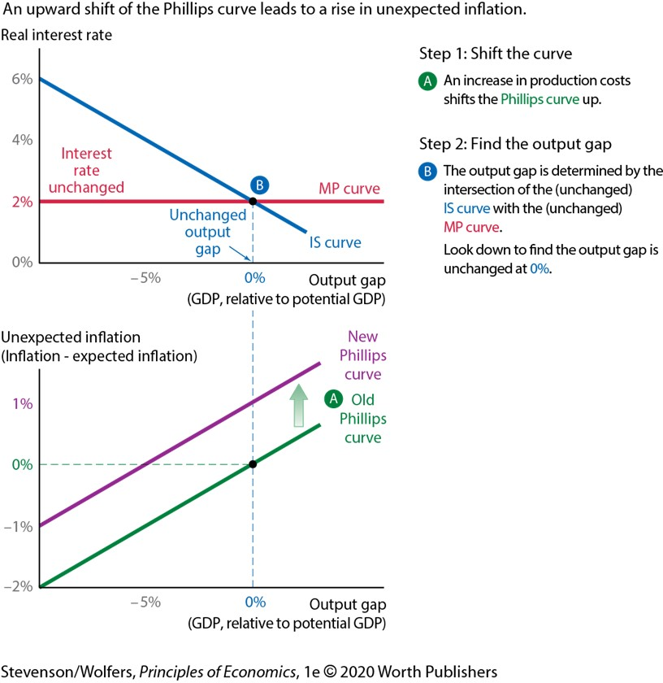
Supply Shocks Shift the Phillips Curve - Step 2
Notes:
Supply Shocks Shift the Phillips Curve - Step 2
Since equilibrium is determined by the intersection of the IS and MP curves, equilibrium does not change when the Phillips curve shifts. Thus, the output gap remains unchanged at 0%.

Slide 38
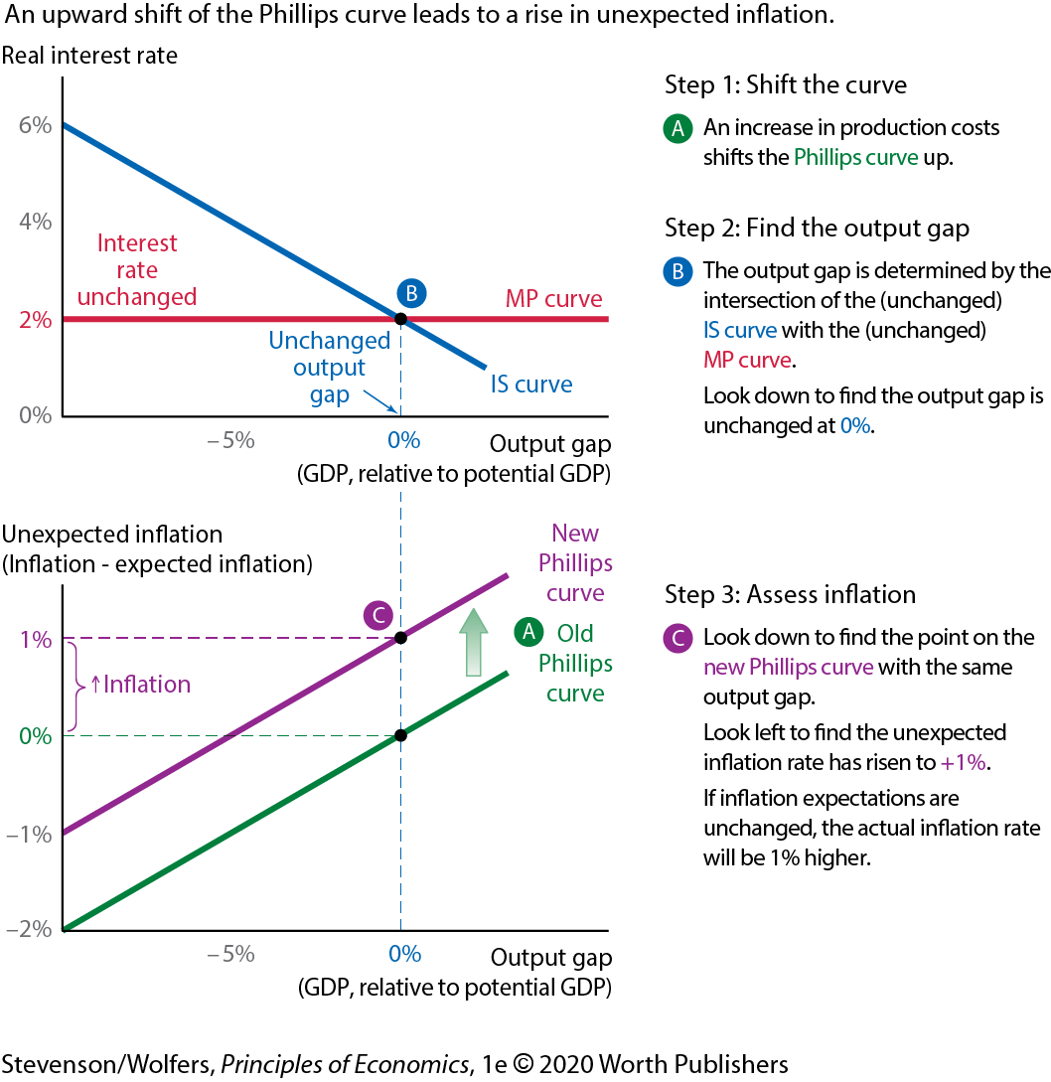
Supply Shocks Shift the Phillips Curve - Step 3
Notes:
Supply Shocks Shift the Phillips Curve - Step 3
Looking at the new Phillips curve, the next step is to identify the point that corresponds to the same output gap. Looking left of that point, the unexpected inflation is +1%.

Slide 39
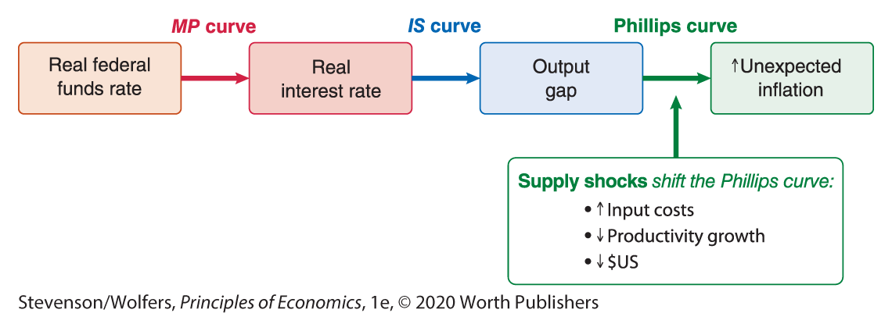
Track the Effects of a Supply Shock.
Notes:
Lecture tips:
A supply shock that shifts the Philips curve up results in higher inflation, with no effect on the real interest rate or the output gap.

Slide 40
Stagflation
A supply shock can cause output to decline.
Stagflation is a combination of economic stagnation — or falling output — combined with high inflation.
Actual and potential output decline.
Notes:
Lecture tips:
Use the oil shocks in the 1970s and 1980s as examples of stagflation.
A good exercise would be to have students look at data from FRED for real GDP, potential GDP, and inflation during a period of stagflation.

Slide 41
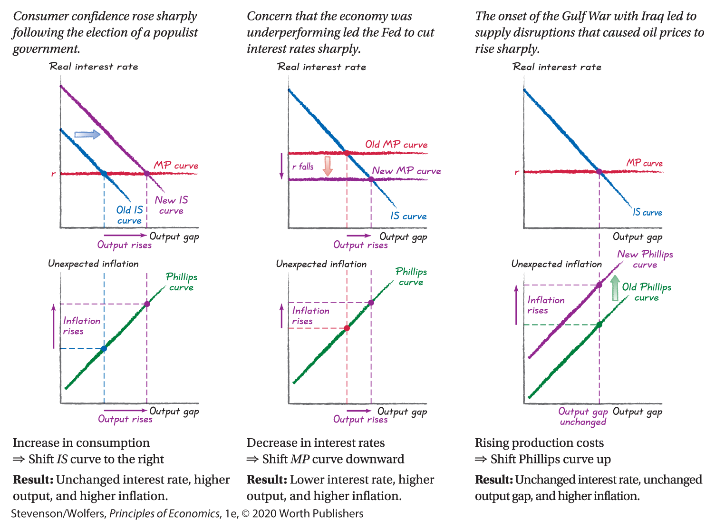
Do the Economics
Notes:
Lecture tips:
Use these slides to practice using the Fed model to predict how the economy will respond as market conditions change. Use the three-step recipe to forecast how real interest rates, the output gap, and inflation will respond.

Slide 42
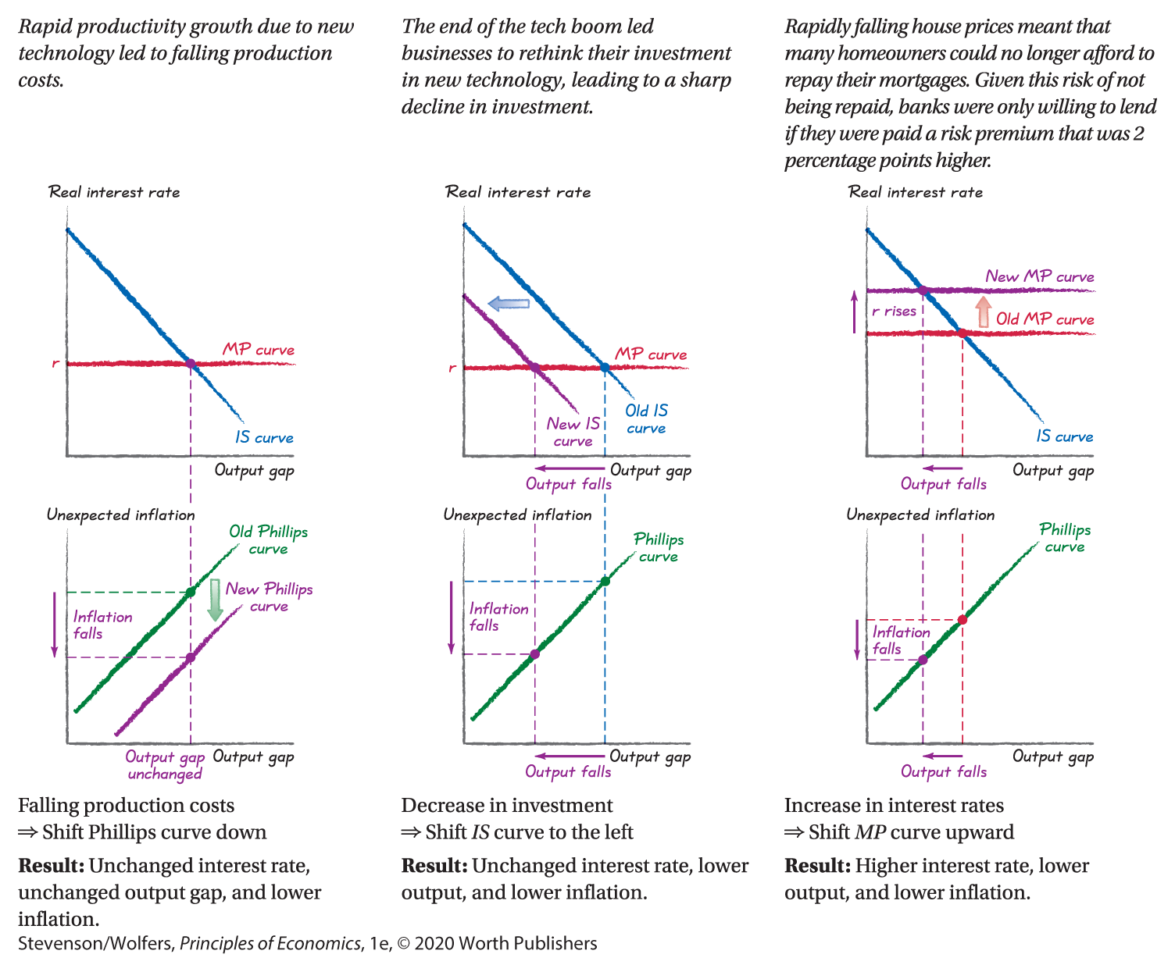
Do the Economics Example 2
Notes:
Lecture tips:
Use these slides to practice using the Fed model to predict how the economy will respond as market conditions change. Use the three-step recipe to forecast how real interest rates, the output gap, and inflation will respond.

Slide 43
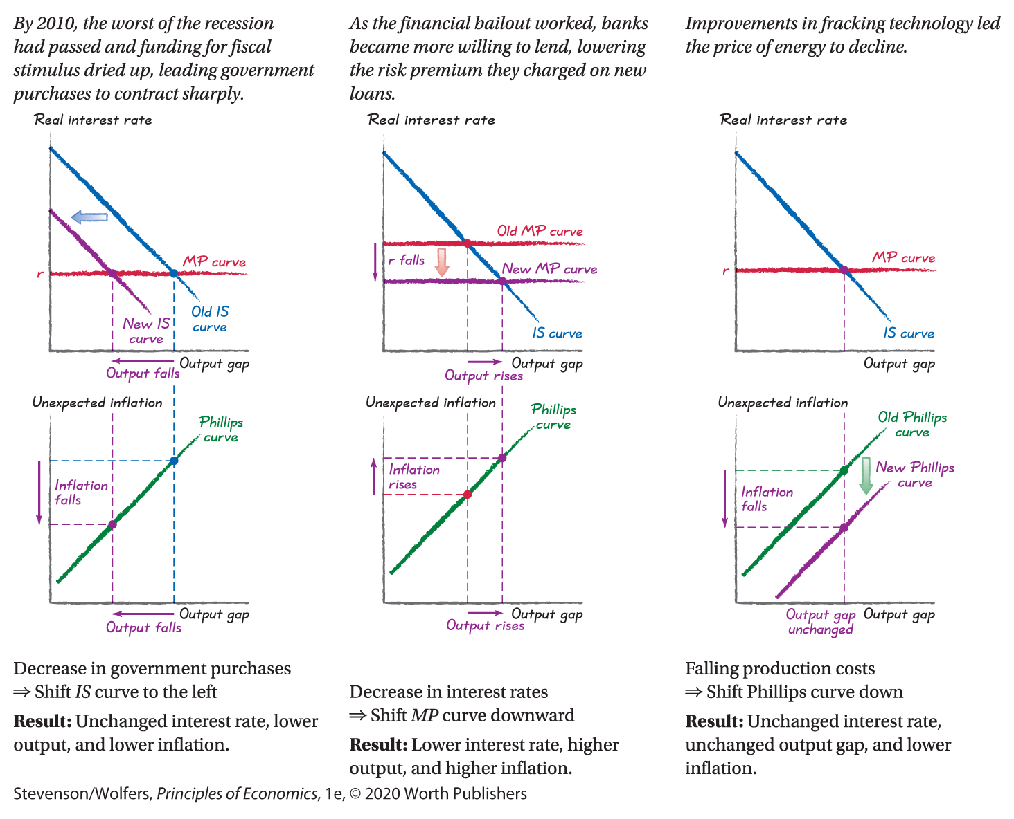
Do the Economics Example 3
Notes:
Lecture tips:
Use these slides to practice using the Fed model to predict how the economy will respond as market conditions change. Use the three-step recipe to forecast how real interest rates, the output gap, and inflation will respond.

Slide 44
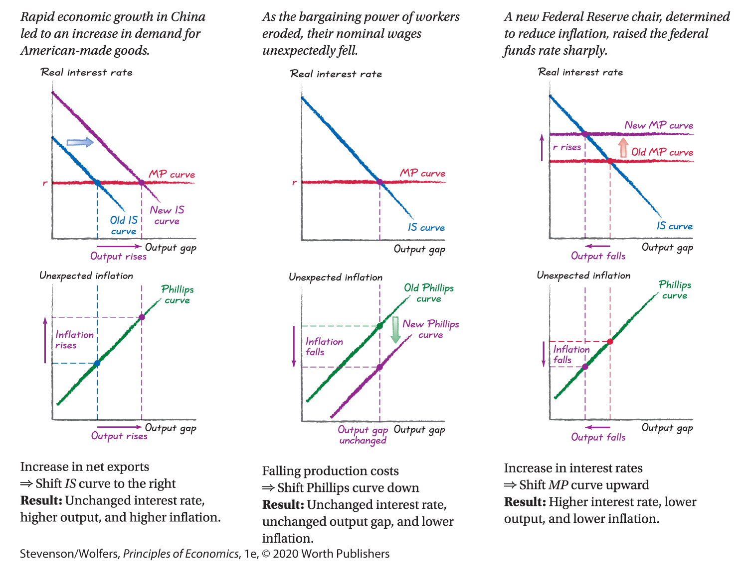
Do the Economics Example 4
Notes:
Lecture tips:
Use these slides to practice using the Fed model to predict how the economy will respond as market conditions change. Use the three-step recipe to forecast how real interest rates, the output gap, and inflation will respond.

Slide 45
Clicker question (3 of 5)
The election of a new U.S. president leads households to become more hopeful about their future economic prospects, which leads them to increase their current consumption. If the output gap was initially zero, the Fed model predicts that
output will rise relative to potential output.
there will be no change in the output gap. output will fall relative to potential output.
- Correct Answer
Notes:
Answer: A
Consumption is a component of aggregate expenditure. The IS curve will increase with increased expenditures, increasing output relative to potential.

Slide 46
Clicker question (4 of 5)
The election of a new U.S. president leads households to become more hopeful about their future economic prospects, which leads them to increase their current consumption. The Fed model predicts that
the real interest rate will rise.
there will be no change in the real interest rate.
the real interest rate will decrease.
- Correct Answer
Notes:
Answer: B
The MP curve does not shift. The IS curve shifts along the horizontal MP curve, so there is no change in the real interest rate.

Slide 47
Clicker question (5 of 5)
The election of a new U.S. president leads households to become more hopeful about their future economic prospects, which leads them to increase their current consumption. If initially unexpected inflation was zero, the Fed model predicts that
the inflation rate will rise.
there will be no change in the inflation rate.
the inflation rate will decrease.
- Correct Answer
Notes:
Answer: A
We will move up the Phillips curve and experience an increase in unexpected inflation and thus an increase in inflation.

Slide 48
Review: Analyzing Macroeconomic Shocks
Use the Fed model to analyze the consequence of macroeconomic shocks.
  Second, identify the shock and shift the curve.
  Next, find the output gap.
  Finally, assess inflation.
The MP curve shifts in response to monetary policy and financial market risks.
The IS curve shifts in response to changes in aggregate expenditure.
The Phillips curve shifts in response to changes in production costs.
Notes:
Lecture tips:
This slide is a brief review of the big takeaways from this section of the lecture, so it repeats some information from previous slides.

Slide 49
Roadmap (3 of 3)
The Fed Model
Analyze the Fed model, which puts together the IS curve, the MP curve, and the Phillips curve.
Analyzing Macroeconomic Shocks
Use the Fed model to analyze the consequences of financial shocks, spending shocks, and supply shocks.
Diagnosing the Causes of Macroeconomic Changes
Use the Fed model to diagnose the causes of economic fluctuations.

Slide 50
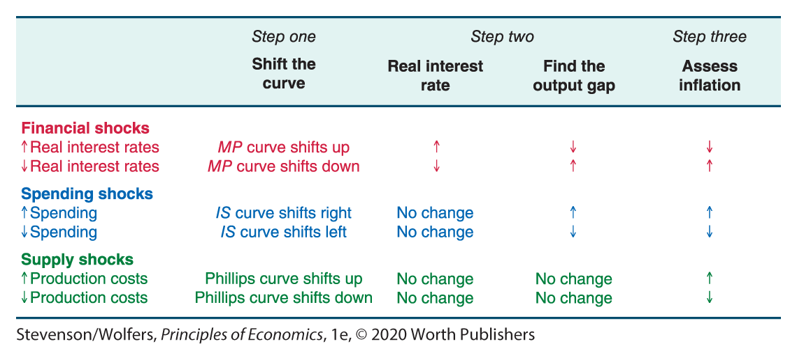
The Consequences of Different Shocks
Notes:
Lecture tips:
Use this slide to review and summarize what we know so far. Then indicate to students that we can also use the model to diagnose causes of economic fluctuations (going in reverse of what we have done so far).

Slide 51
A Diagnosis Tool
We can use the Fed model in reverse as a diagnostic tool when
the real interest rate changes, which points to a financial shock.
the output gap shifts without much change in the real interest rate, which points to a spending shock.
inflation rises in a weak economy (or falls in a strong one), which points to a supply shock.
Notes:
Lecture tips:
Discuss how this type of analysis is beneficial.

Slide 52
Key Takeaways
The Fed model is particularly valuable for answering “what if” questions.
The Fed model provides a coherent way to trace out the consequences of many random shocks.
The Fed model takes a general equilibrium approach by analyzing markets jointly.

