Slide 1
Macroeconomic Theory
Financial Markets

Slide 2
So what does determine interest rates?
And how do they affect GDP?

Slide 3
Central Banking
01

Slide 5
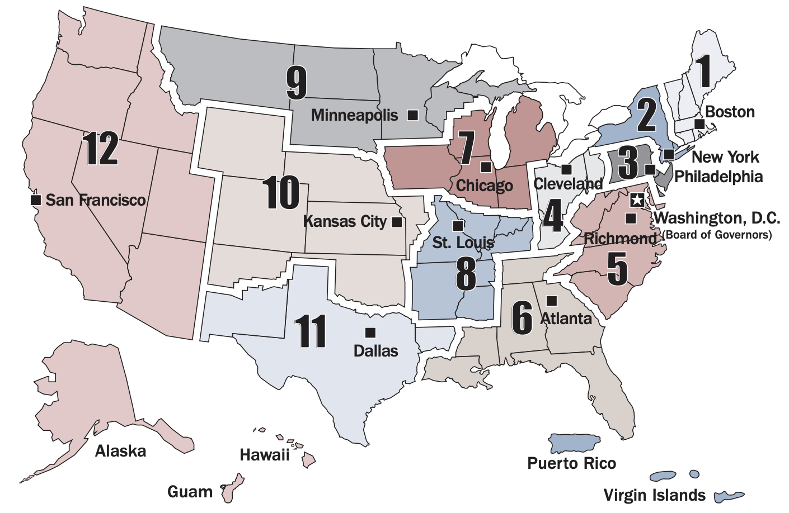

Slide 6
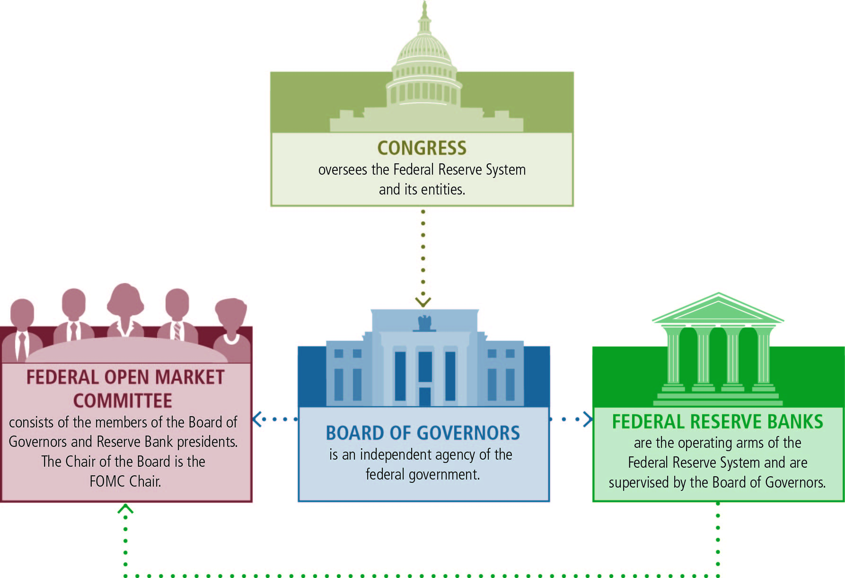

Slide 8
The FOMC and policy making
The Federal Open Market Committee (FOMC) is the Federal Reserve committee that sets U.S. interest rates.
It consists of the Fed governors and the district bank presidents.

Slide 9
The FOMC Meetings
Each member of the FOMC must be prepared to answer three questions at each meeting:
What are your forecasts for the U.S. economy?
What are the right policy choices given the economic outlook?
How should the Fed communicate its plans effectively to the public?

Slide 10
Review of Fed Structure
The Federal Reserve is responsible for setting monetary policy in the United States.
The Fed uses interest rates as a tool to influence the economy.
The Fed is largely independent from political pressure, but it is subject to government oversight.
Monetary policy decisions are made at the FOMC.

Slide 11
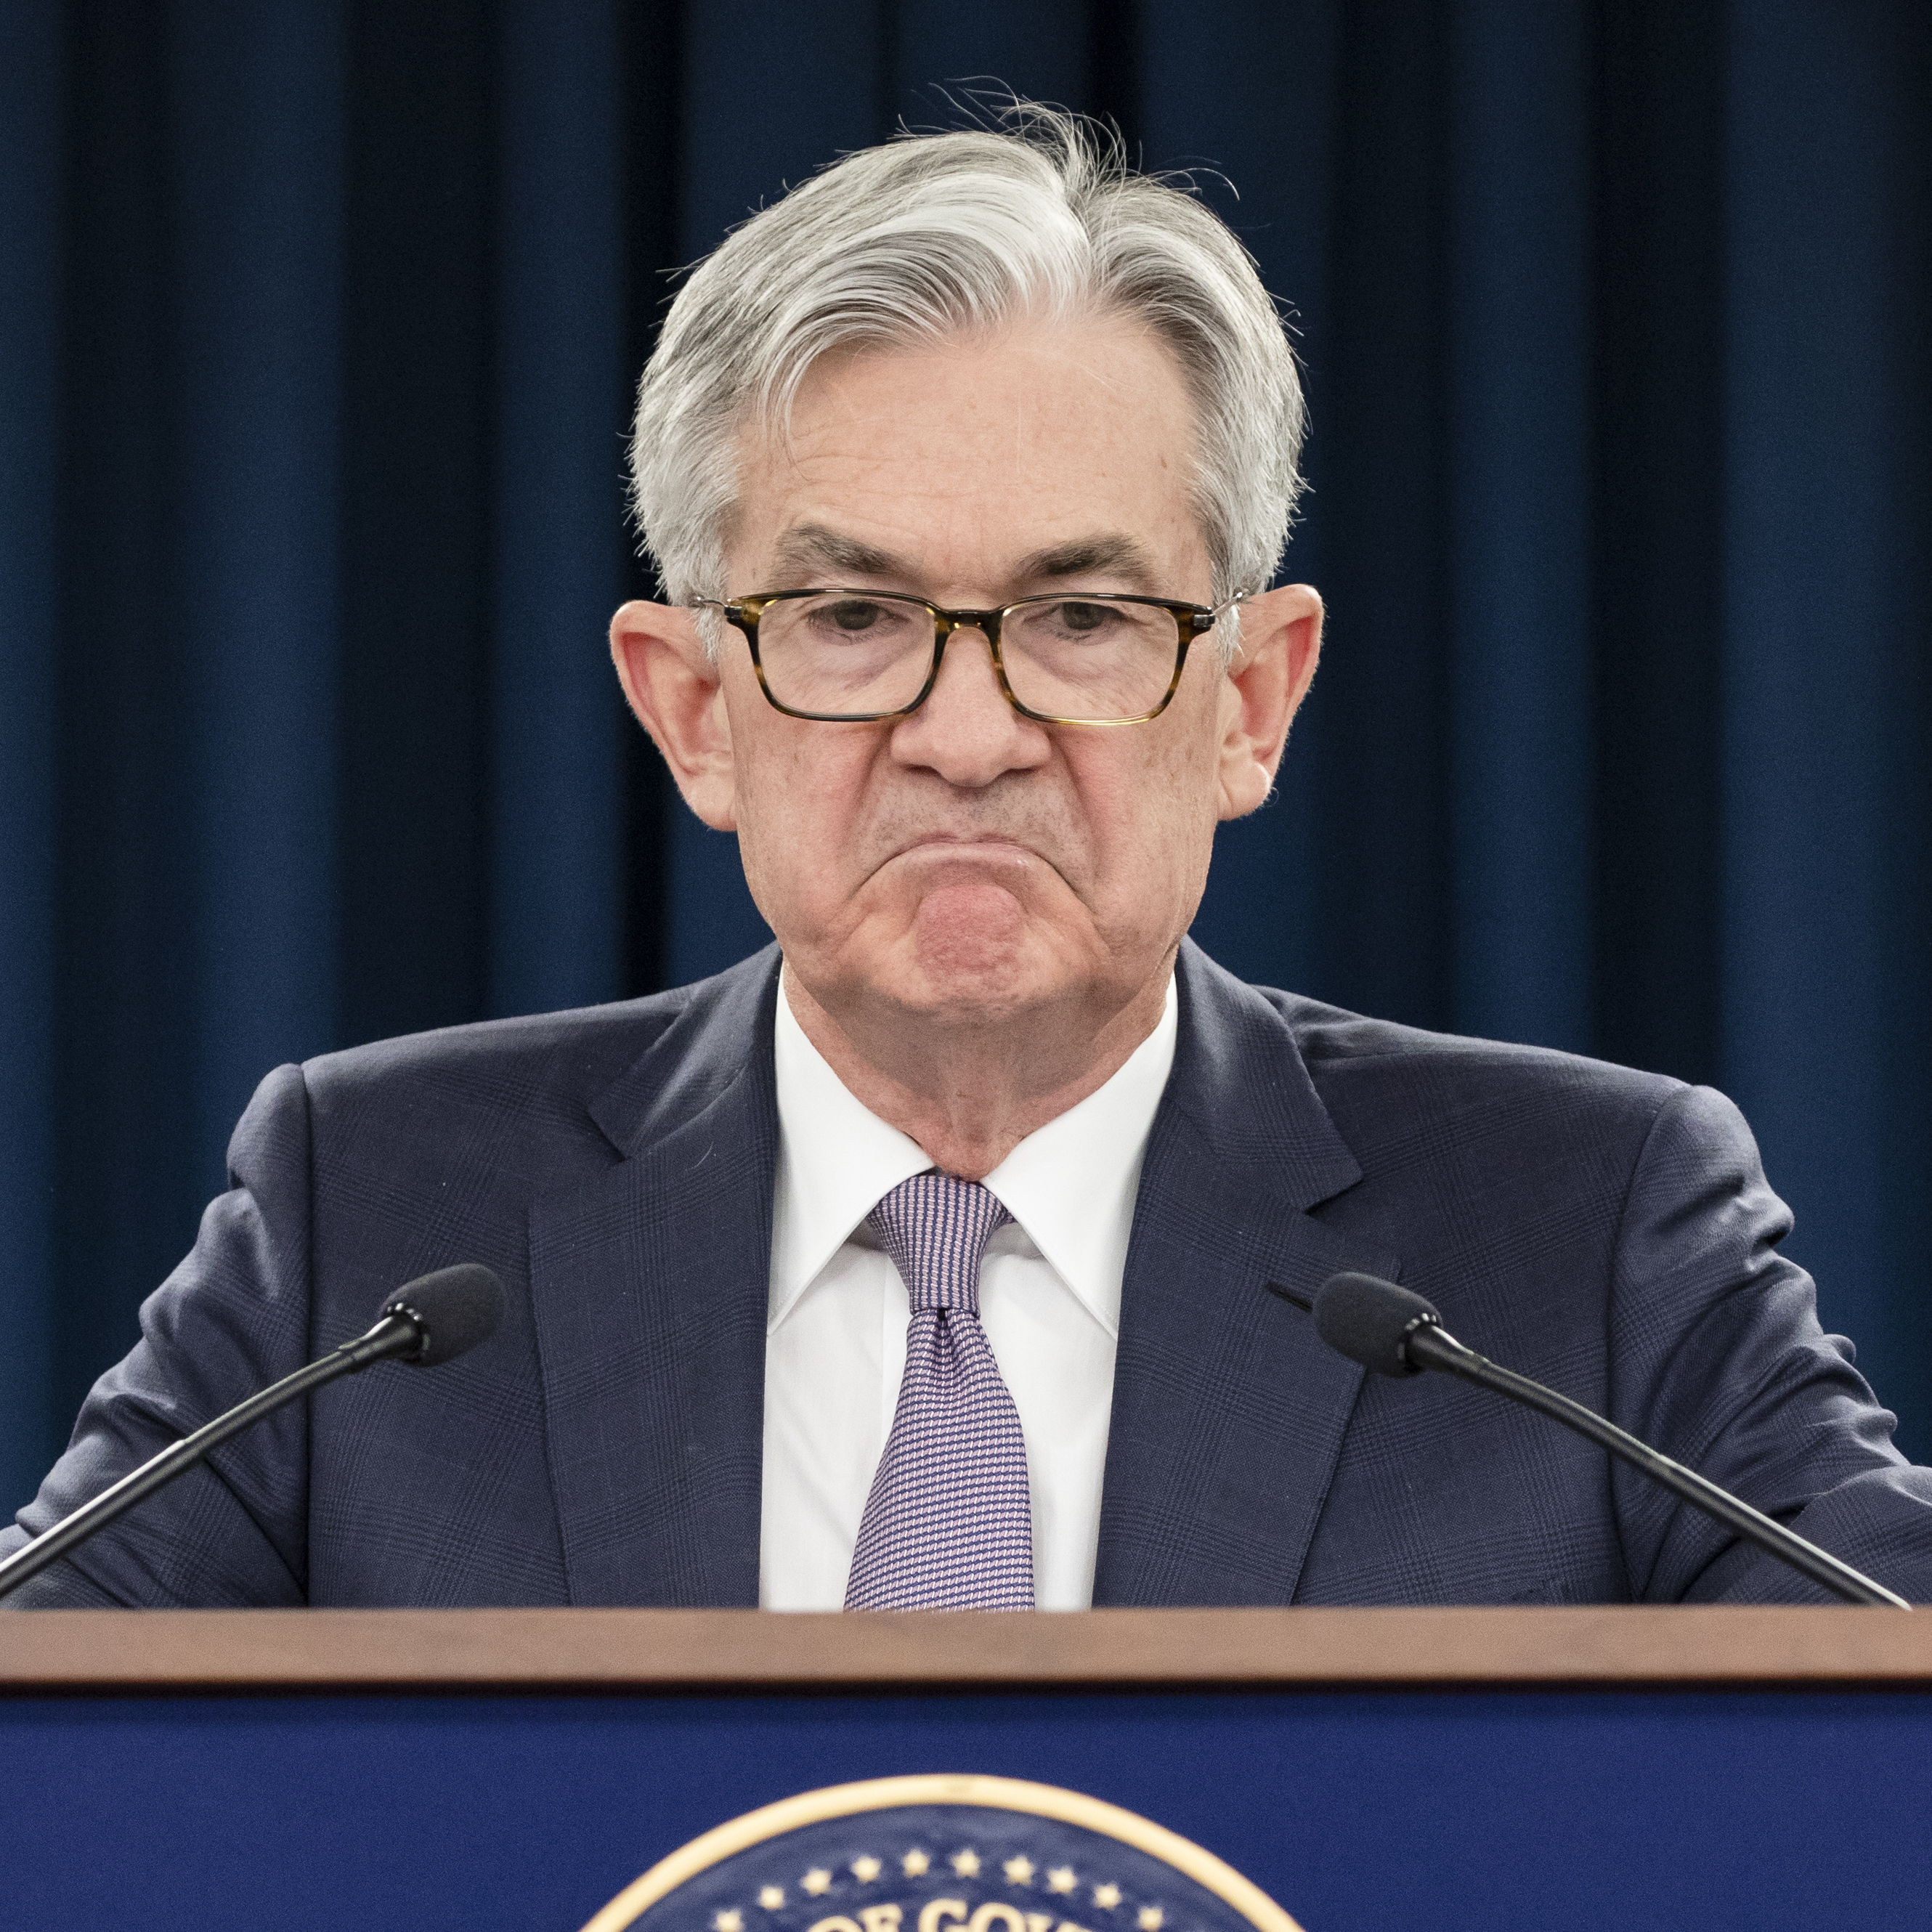
Dual Mandate
Right now the Fed interprets the goal of price stability as conflicting with the goal of maximum employment

Slide 12
The Dual Mandate
The Fed’s two goals of stable prices and maximum sustainable employment are called the Fed’s dual mandate.
A publicly stated goal for the inflation rate is called the inflation target.
Price stability means inflation is near or at the Fed’s inflation target.
Hitting the inflation target promotes maximum sustainable employment.

Slide 13
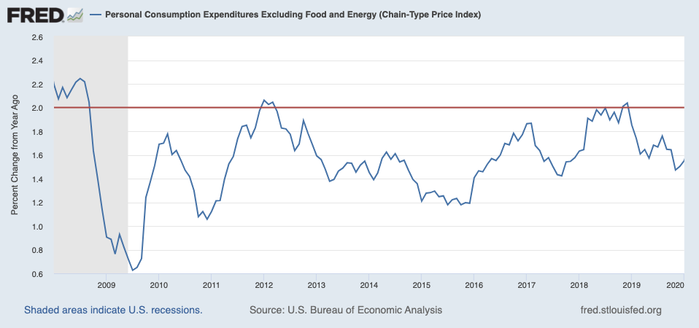
The Dual Mandate

Slide 14
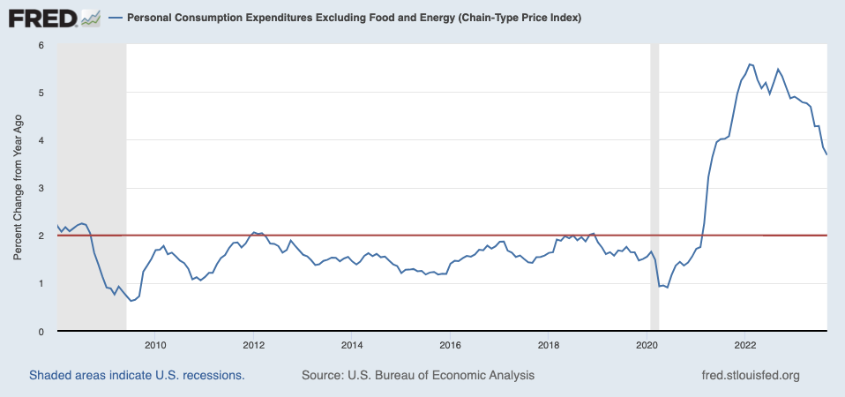
The Dual Mandate

Slide 15
Why not target zero?
The Fed does not target zero inflation because
inflation greases the wheels of the labor market.
the Fed can lower real interest rates when inflation is above zero.
a 0% inflation target runs the risk of deflation.
measured inflation may be overstated.

Slide 16
How the Fed chooses the interest rate
The Fed starts with the neutral real interest rate.
The Fed targets the nominal interest rate when trying to influence the real interest rate.
The Fed compares inflation with its inflation target.
The Fed looks at the output gap.

Slide 17
How the Fed chooses the interest rate

Slide 18
Federal Funds Rate
The federal funds rate is the interest rate that banks charge each other for overnight loans.

Slide 19
Prior to 2008: Expansionary Policy
Trading Desk purchases government securities, such as Treasury bonds, and Fed deposits funds into the bank accounts of the sellers.
That payment becomes part of the reserve balances that commercial banks hold at the Fed; this increases the amount of funds that banks have available to lend.
This injection of reserves into the banking system puts downward pressure on the federal funds rate, which then puts downward pressure on other interest rates

Slide 20
Prior to 2008: Contractionary Policy
Trading desk sells some of the government securities it holds, buyers pay from their bank accounts. This shrinks the funds that banks have available to lend.
That creates upward pressure on the federal funds rate, since banks have fewer reserves available to lend and will charge more to lend them.
As the federal funds rate increases, so do other rates.

Slide 21
The global financial crisis was so severe that the federal reserve pumped enough reserves to drive the Federal Funds rate to zero… and then some.
We are now in an “ample reserves” scenario so traditional policy won’t work
In fact, there are no longer any reserve requirements

Slide 22
Two Key Tools
Overnight Reverse Repurchase Agreement:
the Desk sells securities to a counterparty subject to an agreement to repurchase the securities at a later date
Interest on Reserve Balances
The Fed pays interest on reserve balances

Slide 23
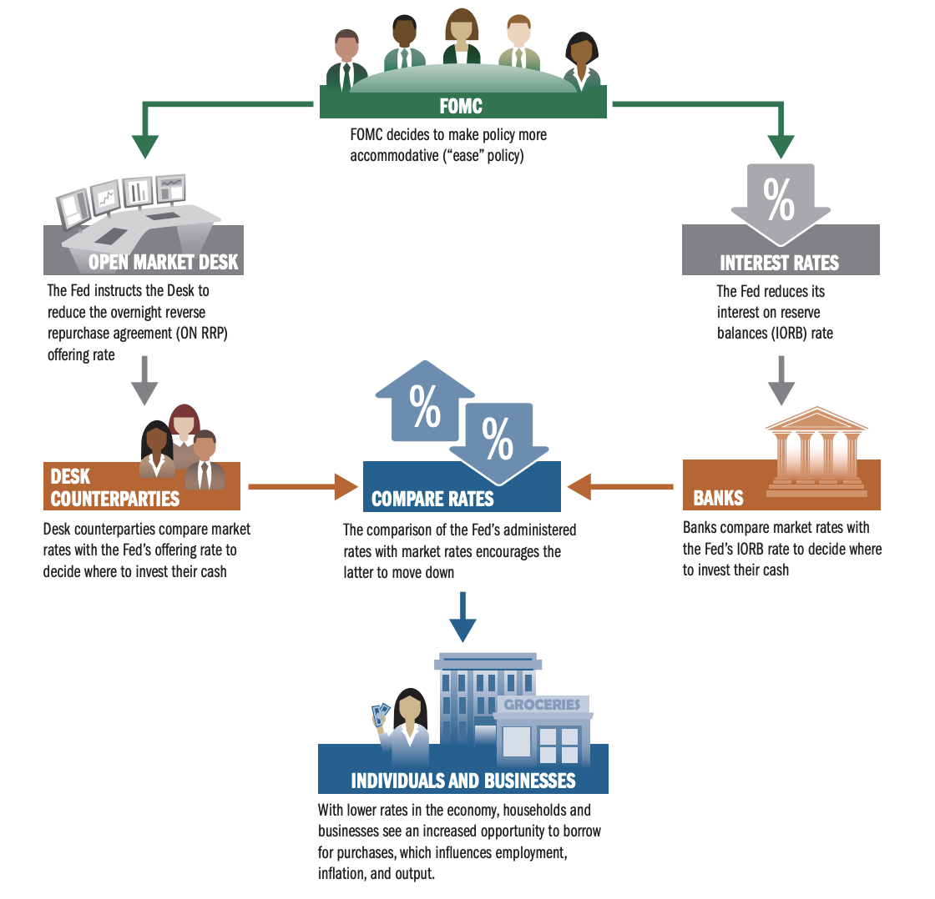

Slide 24
The Ripple Effect
A change in the federal funds rate percolates through to other interest rates.
Interest rates change the value of consuming today versus tomorrow.
Interest rates change the value of the U.S. dollar.

Slide 25
The Ripple Effect
A change in the federal funds rate percolates through to other interest rates.
Interest rates change the value of consuming today versus tomorrow.
Interest rates change the value of the U.S. dollar.

Slide 26
Fed increases its policy interest rate
Other rates increase and financial conditions tighten
Spending falls
Jobs become scarce
Wages moderate
Prices moderate

Slide 27
Fed increases its policy interest rate
Other rates increase and financial conditions tighten
Spending falls
Jobs become scarce
Wages moderate
Prices moderate
“The Fed’s current plan is to increase unemployment by 1 percent over the next year, throwing 1.6 million people out of work.
If the link between labor market conditions and prices is not as tight as they think, that’s a lot of suffering being inflicted for no reason..”
– Mason (2023)

Slide 28
Additional Interest Rates
03

Slide 29
Beyond the Fed
Beyond the key interest rates the Fed determines… how are interest rates set?
This requires a little primer on risk premia

Slide 30
Risk Premia
The federal funds rate, set by the Fed, is effectively a risk-free short term interest rate
Government bonds also serve as a risk free rate at longer maturities
The extra interest that lenders charge to account for the risk of loaning money is called a risk premium.
Borrower interest rate = Risk-free interest rate + Risk premium

Slide 31
Evaluating Risk
There are multiple types of risk associated with interest rates:
default risk.
liquidity risk
interest rate risk
risk aversion of lenders

Slide 32
Default Risk
The risk that your loan won’t be repaid is called default risk.
Companies are given credit ratings to help investors assess risk.

Slide 33
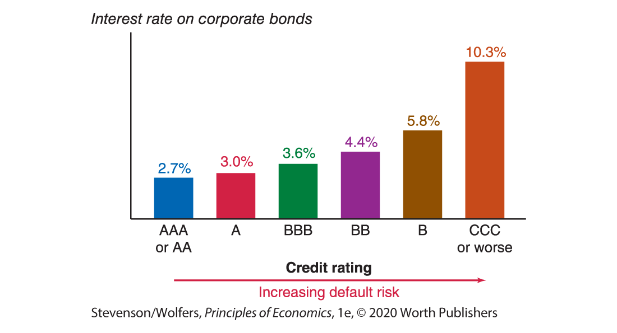
Default Risk

Slide 34
Liquidity Risk
The risk that if you need to sell an asset quickly, you may not be able to get a good price for it is called liquidity risk.
When banks need cash—that is, liquidity—they can usually get it by selling some of their loans to other lenders. Liquidity risk arises when disruptions in financial markets mean that there aren’t any buyers, or there aren’t any willing to pay a reasonable price.

Slide 35
Term Risk
The risk that arises from uncertainty about future interest rates is called term risk.
Tying up your money involves an opportunity cost.
This risk is connected to the length (or term) of the loan.

Slide 36
Risk Aversion
When lenders become more reluctant to take on risk—that is, when they become more risk averse—they’ll only be willing to make a loan if they can charge a higher risk premium.

Slide 37
Recap
The nominal interest rate that actual borrowers face can be thought of as:
Borrower interest rate =
Risk-free interest rate + Risk premium

Slide 38
Real Interest Rates
04

Slide 39
Nominal interest rate is the interest rate in terms of dollars.
Real interest rate is the interest rate in terms of a basket of goods.
We must adjust the nominal interest rate to take into account expected inflation.

Slide 40
If the nominal interest rate and expected inflation are not too large, a close approximately to the last equation is:
$$r_{t}≈i_{t}− π_{t+1}^{e}$$

Slide 41
When expected inflation equals zero, the nominal interest rate and the real interest rate are equal.
Because expected inflation is typically positive, the real interest rate is typically lower than the nominal interest rate.
For a given nominal interest rate, the higher expected inflation, the lower the real interest rate.

Slide 42
The real interest rate (1 − π^{e}) is based on expected inflation, so it is sometimes called the ex-ante (“before the fact”) real interest rate.
The realized real interest rate (1 − π) is called the ex-post (“after the fact”) interest rate.
The zero lower bond of the nominal interest rate implies that the real interest rate cannot be lower than the negative of inflation.

Slide 43
The real interest rate (1 − π^{e}) is based on expected inflation, so it is sometimes called the ex-ante (“before the fact”) real interest rate.
The realized real interest rate (1 − π) is called the ex-post (“after the fact”) interest rate.
The zero lower bond of the nominal interest rate implies that the real interest rate cannot be lower than the negative of inflation.

Slide 44
Final Interest Rate
In the end we will assume that any particular borrower makes decisions based on the real interest rate they face:
Borrower real interest rate =
Risk-free interest rate + Risk premium – Expected Inflation

Slide 45
Final Interest Rate
In the end we will assume that any particular borrower makes decisions based on the real interest rate they face:
Borrower real interest rate =
Risk-free interest rate + Risk premium – Expected Inflation
$$r= (i−π^{e}+x)$$

Slide 46
Side Note on Banking Crises
05

Slide 47
Bank Balance Sheet Revisited
Assets
Liabilities
100
80
Capital: 20
Capital ratio: Capital/Assets = 20/100 = 20%
Leverage ratio: Assets/Capital = 100/20 = 5

Slide 48
Bank Crises
higher leverage ratio implies a higher expected profit rate,
but also implies a higher risk of insolvency and bankruptcy.
Liquidity problems can become solvency problems…

Slide 49
Liquidity and Risk
The lower the liquidity of bank assets means the more difficult they are to sell, the higher the risk of being sold at fire sale prices (prices far below the true value) and the risk that the bank becomes insolvent.
The higher the liquidity of the liabilities (e.g., checkable or demand deposits), the higher the risk of fire sales, and the risk that the bank becomes insolvent and thus faces bank runs.

Slide 50
Say investors doubt the value of bank assets and demand to liquidate uninsured short term loans to bank →
Cannot easily call in loans, and therefore must sell loans →
But markets have doubts about these loans so sell at fire sale prices →
Fire sale prices mean assets lower, closer to insolvency and investors want funds back →
More fire sales →
Insolvency
Note that if investors are worried about a class of assets, then the market gets flooded with these at the very same time investors are worried → extreme declines in prices

Slide 51
All of this implies that a reduction in the liquidity of assets, combined with demands to liquidate liabilities reduce the willingness and ability of banks to make loans.
In our model this would be represented as an increase in x.

Slide 52
The IS Relation
06

Slide 53
Interest Rates and the Economy
Lower real interest rates boost:
Consumption
Lower reward for saving, lower cost of borrowing (durables)
investment.
Lower opportunity cost, lower cost of borrowing (residential)
- net exports
U.S. dollar cheaper

Slide 54
Interest Rates and net exports
A low real interest rate in the United States leads international money managers to send their funds to other countries that offer better returns.
This means they’ll demand fewer U.S. dollars, leading the dollar to become cheaper.
This cheaper dollar increases exports and reduces imports.

Slide 55
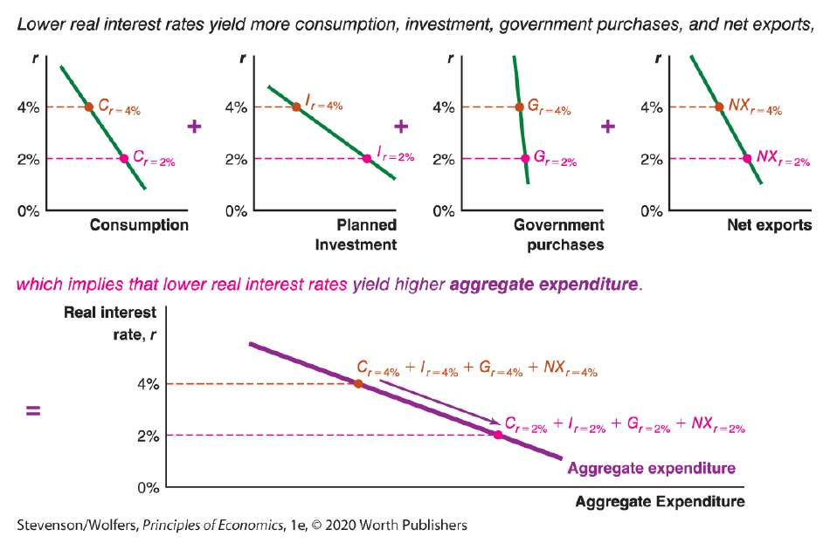

Slide 57
The IS Curve
The IS curve illustrates how lower real interest rates raise spending and hence GDP
For our first go, let’s keep things simple and assume that only investment is sensitive to interest rates

Slide 58
$$I = I\left(Y, i\right)$$
$(\text{+, }−)$
$$I =b_{0}+b_{1}Y−b_{2}i$$
Investment that does not depend on income/sales or interest rate – sometimes thought of as “animal spirits”
Investment that responds to changes in income/sales
Investment that is sensitive to interest rates

Slide 59
C$=c_{0}+c_{1}Y_{D}$
T$= \overline{T}$
$$I =b_{0}+b_{1}Y−b_{2}i$$
G$= \overline{G}$
Z$=c_{0}+c_{1}(Y−\overline{T})+b_{0}+b_{1}Y−b_{2}i$ + $\overline{G}$

Slide 60
The IS curve shows all points of income equilibrium given a particular interest rate

Slide 61
Demand(Z)
Z² (demand at i²)
At interest rate i¹, equilibrium income and demand will be Y¹
Z¹(demand at i¹)
Interest rate (i)
At interest rate i², equilibrium income and demand will be Y²
i¹
i²
IS
Y¹
Y²

Slide 62
Z$=c_{0}+c_{1}(Y−\overline{T})+b_{0}+b_{1}Y−b_{2}i$ + $\overline{G}$
Z$=Y$
Y$=c_{0}+c_{1}(Y−\overline{T})+b_{0}+b_{1}Y−b_{2}i$ + $\overline{G}$
Y$=\frac{1}{(1−c_{1}−b_{1})}{\left[c_{0}−c_{1}\overline{T}−b_{2}i+\overline{G}\right]}_{ }$

Slide 63
Interest rate (i)
What happens if autonomous spending increases?
(increase in G, fall in T, increase in b₀)
IS²
IS¹
Y

Slide 64
Interest rate (i)
What happens if investment becomes more sensitive to the interest rate?
(increase in b₂)
IS²
IS¹
Y

Slide 65
Interest rate (i)
What happens if marginal propensity to consume increases?
(increase in c₁)
IS²
IS¹
Y

Slide 66
The MP Curve
03

Slide 67
Interest rate (i)
The MP curve tells us the rate faced by borrowers
MP¹
IS¹
Y

Slide 68
Interest rate (i)
The MP curve is:
$$r= (i−π^{e}+x)$$
MP¹
IS¹
Y

Slide 69
Interest rate (i)
The MP curve shifts:
- with changes in the risk free rate
- with changes in expected inflation
- with changes in the risk premium
MP¹
IS¹
Y

Slide 70
Two “loops”
Multiplier loop
Fed interest rate
Investment
–
+
+
Government Spending
Income
Net Exports
+
+
+
+
Taxes and Transfers
Disposable Income
Consumption
–
+

Slide 71
Two “loops”
Multiplier loop
Investment loop (accelerator)
Fed interest rate
Investment
–
+
+
Government Spending
Income
Net Exports
+
+
+
+
Taxes and Transfers
Disposable Income
Consumption
–
+

Slide 72
consumption and investment components
IOR and the ON RRP
FOMC increases interest rates
Decrease in Investment
Multiplier effects
Decrease in output/income
Particularly residential investment
Direct effect of lower investment and multiplier effect combined

