Slide 1
Macroeconomic Theory
Financial Markets I

Slide 2
A mystery
So what does determine interest rates?

Slide 3
What determines interest rates?
Balance Sheets
Review
1
2
3
4
Types of Money
Banks as Money Creators

Slide 4
Types of Money
01

Slide 5
Four Prices of Money
Interest rate: money today in terms of money tomorrow

Slide 6
Four Prices of Money
Interest rate: money today in terms of money tomorrow
Par: one money in terms of another today

Slide 7
Four Prices of Money
Interest rate: money today in terms of money tomorrow
Par: one money in terms of another today
Exchange rate: domestic money in terms of foreign money

Slide 8
Four Prices of Money
Interest rate: money today in terms of money tomorrow
Par: one money in terms of another today
Exchange rate: domestic money in terms of foreign money
Price level: money in terms of goods

Slide 9
Four Prices of Money
Interest rate: money today in terms of money tomorrow
Par: one money in terms of another today
Exchange rate: domestic money in terms of foreign money
Price level: money in terms of goods

Slide 10
What is money??
Cash/coin?

Slide 11
What is money??
Cash/coin?
Check?

Slide 12
What is money??
Cash/coin?
Check?
Credit card?

Slide 13
Economists often define money by its functions

Slide 14
Medium of Exchange

Slide 15
Store of Value

Slide 16
Unit of Account

Slide 17
Settlement Asset

Slide 18
But… what is it?
If those are things money does, what actually serves as money?

Slide 19
But… what is it?
If those are things money does, what actually serves as money?
This depends on who you are and what you need to do!

Slide 20
Fiat Currency
Printed and guaranteed by the government
Federal Reserve stands ready to convert reserves to fiat currency
Majority of bills are $100 and probably circulate internationally

Slide 21
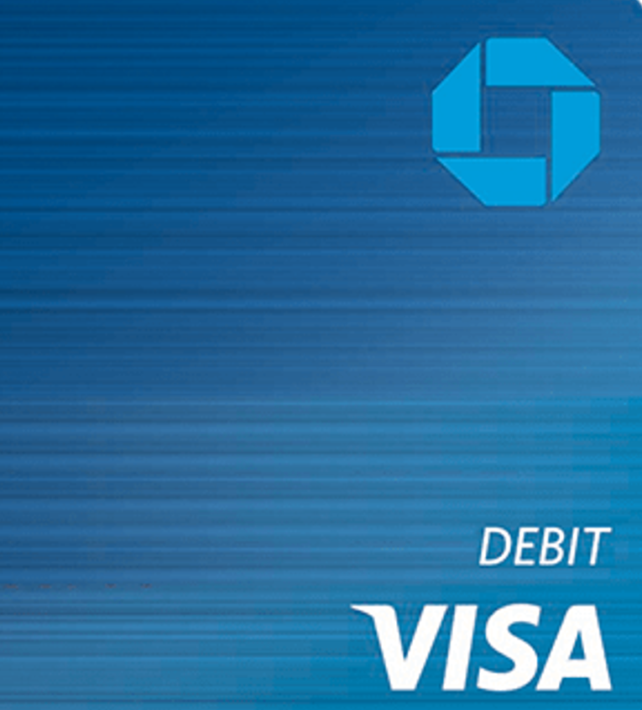
Bank Deposits
Convertible to currency at par
Created when loans are made
Debit cards, checks, electronic fund transfers

Slide 22
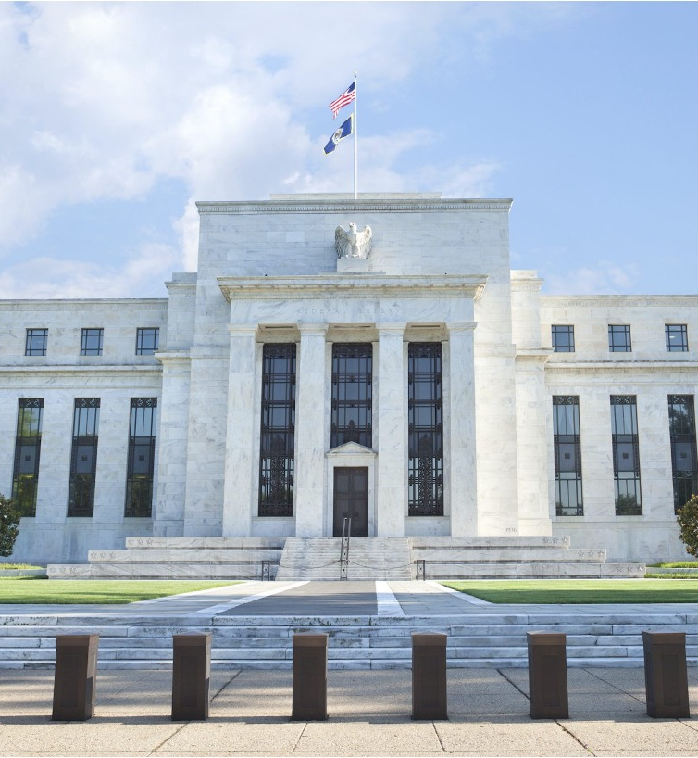
Central Bank Reserves
Created when the CB buys
financial assets or makes loans
Used by commercial banks to settle with each other
Never leave the CB’s balance sheet – just moved around

Slide 23
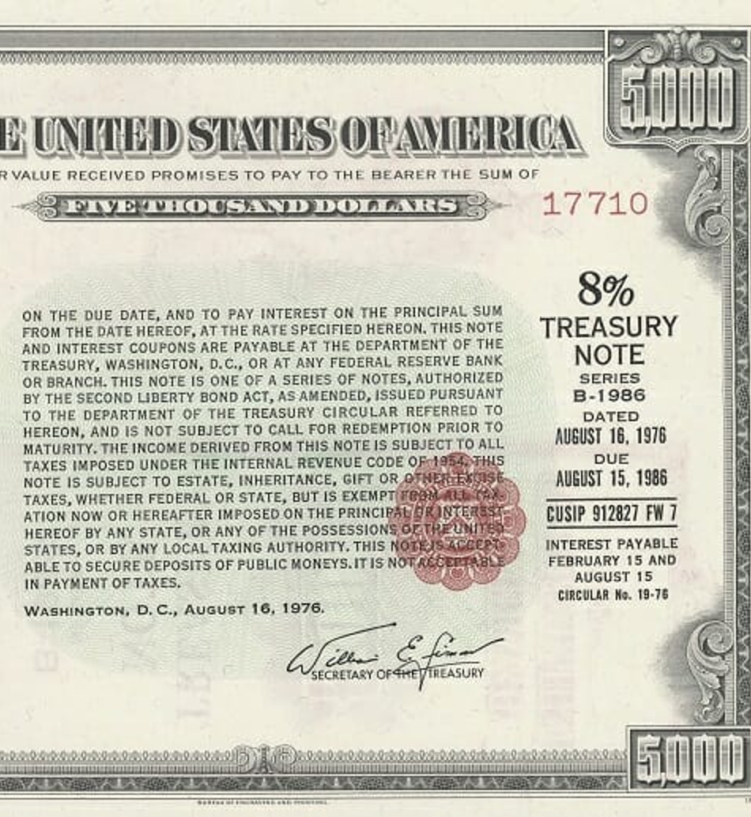
Treasuries
Debt issued by US federal government
Risk-free with deep and liquid market
Large investors use when bank accounts wouldn’t make sense

Slide 24
Practice Problem
01

Slide 25
Balance Sheets
02

Slide 26
What is a balance sheet?
An accounting document that records:
what an economic unit owns (its “assets”)
and what it owes (its “liabilities”).
It measures stocks at a fixed point in time

Slide 27
How Balance Sheets Balance
The rule of the balance sheet is:
Assets = Liabilities + Net Worth
or
Net Worth = Assets – Liabilities

Slide 28
Drawing the T
Assets
Liabilities

Slide 29
Example: Homeowner
Assets
Liabilities
+$80k (Mortgage)

Slide 30
Example: Homeowner
Assets
Liabilities
+$100k (House)
+$80k (Mortgage)

Slide 31
Example: Homeowner
Assets
Liabilities
+$100k (House)
+$80k (Mortgage)
+$20k (Home equity)

Slide 32
Example: Homeowner
Assets
Liabilities
+$100k (House)
+$80k (Mortgage)
+$20k (Home equity)
(net worth)

Slide 33
Loose Balance Sheets
It will be common for us in this course to use stylized balance sheets

Slide 34
Loose Balance Sheets
It will be common for us in this course to use stylized balance sheets
We will also often focus on changes in balance sheet items – ignoring items that do not change

Slide 35
Practice Problem
02

Slide 36
Banks as Money Creators
03

Slide 37
Commercial Banks
Bank loans ➝ deposits
Bank money creation limited by profitability
Central banks do not control the amount of bank money

Slide 38
A Typical Bank Balance Sheet
Assets
Liabilities
Reserve balances and vault cash

Slide 39
A Typical Bank Balance Sheet
Assets
Liabilities
Reserve balances and vault cash
Loans and leases
Notes:
Commercial and industrial loans
loans secured by real estate
loans to finance agricultural production
loans to individuals—including credit card loans

Slide 40
A Typical Bank Balance Sheet
Assets
Liabilities
Reserve balances and vault cash
Loans and leases
Trading account assets (securities)

Slide 41
A Typical Bank Balance Sheet
Assets
Liabilities
Reserve balances and vault cash
Loans and leases
Trading account assets (securities)
Nonfinancial assets

Slide 42
A Typical Bank Balance Sheet
Assets
Liabilities
Reserve balances and vault cash
Loans and leases
Trading account assets (securities)
Nonfinancial assets
Deposits

Slide 43
A Typical Bank Balance Sheet
Assets
Liabilities
Reserve balances and vault cash
Loans and leases
Trading account assets (securities)
Nonfinancial assets
Deposits
Bonds
Notes:
Bank borrowing in the federal funds market and at the discount window of the Fed is short term. Other nondeposit borrowing can be short term in the form of issuing obligations in the money market, or intermediate to long term in the form of issuing securities in the bond market. An example of the former is the repurchase agreement (or “repo”) market. An example of intermediate- or long-term borrowing is floating-rate notes and bonds.

Slide 44
A Typical Bank Balance Sheet
Assets
Liabilities
Reserve balances and vault cash
Loans and leases
Trading account assets (securities)
Nonfinancial assets
Deposits
Bonds
Net worth/equity/capital
Notes:
Bank borrowing in the federal funds market and at the discount window of the Fed is short term. Other nondeposit borrowing can be short term in the form of issuing obligations in the money market, or intermediate to long term in the form of issuing securities in the bond market. An example of the former is the repurchase agreement (or “repo”) market. An example of intermediate- or long-term borrowing is floating-rate notes and bonds.

Slide 45
A Typical Bank Balance Sheet
Assets
Liabilities
Reserve balances and vault cash
Loans and leases
Trading account assets (securities)
Nonfinancial assets
Deposits
Bonds
Net worth/equity/capital

Slide 46
How Banks Make Money
Banks earn profits when:
Interest rate on assets > interest rate on liabilities
Assets
Liabilities
Loans at 6%
Deposits at 0.1%

Slide 47
Bank Problems
Solvency
Is net worth < 0 ?
or
Are assets > liabilities?
Liquidity
Does the bank have cash reserves to make good on payments?
If not, what are consequences for solvency?

Slide 48
Bank Money Creation Example
Olivia would like to purchase a $600,000 house
$60,000 “down”
$540,000 mortgage

Slide 49
Olivia
Chase Bank
Assets
Liabilities
Assets
Liabilities
$60,000 savings
$60,00 savings

Slide 50
Olivia
Chase Bank
Assets
Liabilities
Assets
Liabilities
$60,000 savings
+ $540,000 mortgage
+ $540,000 mortgage
$60,00 savings

Slide 51
Olivia
Chase Bank
Assets
Liabilities
Assets
Liabilities
$60,000 savings
+ $540,000 mortgage
+ $540,000 mortgage
$60,00 savings
+ $540,000 deposit
+ $540,000 deposit

Slide 52
Olivia
Chase Bank
Assets
Liabilities
Assets
Liabilities
-$60,000 savings
+ $540,000 mortgage
+ $540,000 mortgage
- 60,00 savings
- $540,000 deposit (Nick)
- $540,000 deposit
Sarah
Assets
Liabilities

Slide 53
Olivia
Chase Bank
Assets
Liabilities
Assets
Liabilities
-$60,000 savings
+ $540,000 mortgage
+ $540,000 mortgage
- 60,00 savings
- $540,000 deposit (Nick)
- $540,000 deposit
+ $600,000 deposit (Sarah)
Sarah
Assets
Liabilities
+$600,000 deposit (Chase)

Slide 54
Olivia
Chase Bank
Assets
Liabilities
Assets
Liabilities
-$60,000 savings
+ $540,000 mortgage
+ $540,000 mortgage
- 60,00 savings
- $540,000 deposit (Nick)
- $540,000 deposit
+ $600,000 house
+ $600,000 deposit (Sarah)
Sarah
Assets
Liabilities
+$600,000 deposit (Chase)
-$600,000 house

Slide 55
Bye Olivia!

Slide 56
If there were only one bank, this is where it would end

Slide 57
If there were only one bank, this is where it would end
But lets assume Sarah banks at Bank of America…

Slide 58
Sarah
Chase Bank
Assets
Liabilities
Assets
Liabilities
$600,000 deposit (Chase)
+ $600,000 deposit (Sarah)
BofA
Assets
Liabilities

Slide 59
Sarah
Chase Bank
Assets
Liabilities
Assets
Liabilities
$600,000 deposit (Chase)
-$600,000 deposit
(chase)
+ $600,000 deposit (Sarah)
-$600,000 deposit
(Sarah)
BofA
Assets
Liabilities
+$600,000 deposit
(Sarah)

Slide 60
Why would Bank of America take on a liability from Chase?

Slide 61
Chase might:
Be owed by BofA so it nets out

Slide 62
Chase might:
Be owed by BofA so it nets out
Transfer reserves it holds in its account at Fed

Slide 63
Chase might:
Be owed by BofA so it nets out
Transfer reserves it holds in its account at Fed
Borrow reserves from another bank/investor

Slide 64
Chase might:
Be owed by BofA so it nets out
Transfer reserves it holds in its account at Fed
Borrow reserves from another bank/investor
Sell assets for reserves

Slide 65
Chase might:
Be owed by BofA so it nets out
Transfer reserves it holds in its account at Fed
Borrow reserves from another bank/investor
Sell assets for reserves
Borrow reserves from the Federal Reserve itself

Slide 66
The process by which payments are cleared is called settlement

Slide 67
The process by which payments are cleared is called settlement
The asset accepted in payment is called a settlement asset

Slide 68
Sarah
Chase Bank
Assets
Liabilities
Assets
Liabilities
$600,000 deposit (Chase)
-$600,000 deposit
(chase)
-$600,000 reserves
+ $600,000 deposit (Sarah)
-$600,000 deposit
(Sarah)
BofA
Assets
Liabilities
+$600,000 reserves
+$600,000 deposit
(Sarah)

Slide 69
Practice Problem
03

Slide 70
Review
04

Slide 71
What determines interest rates? (part 2)
Balance Sheets
Review
1
2
3
4
Types of Money
Banks as Money Creators

